Slide 1
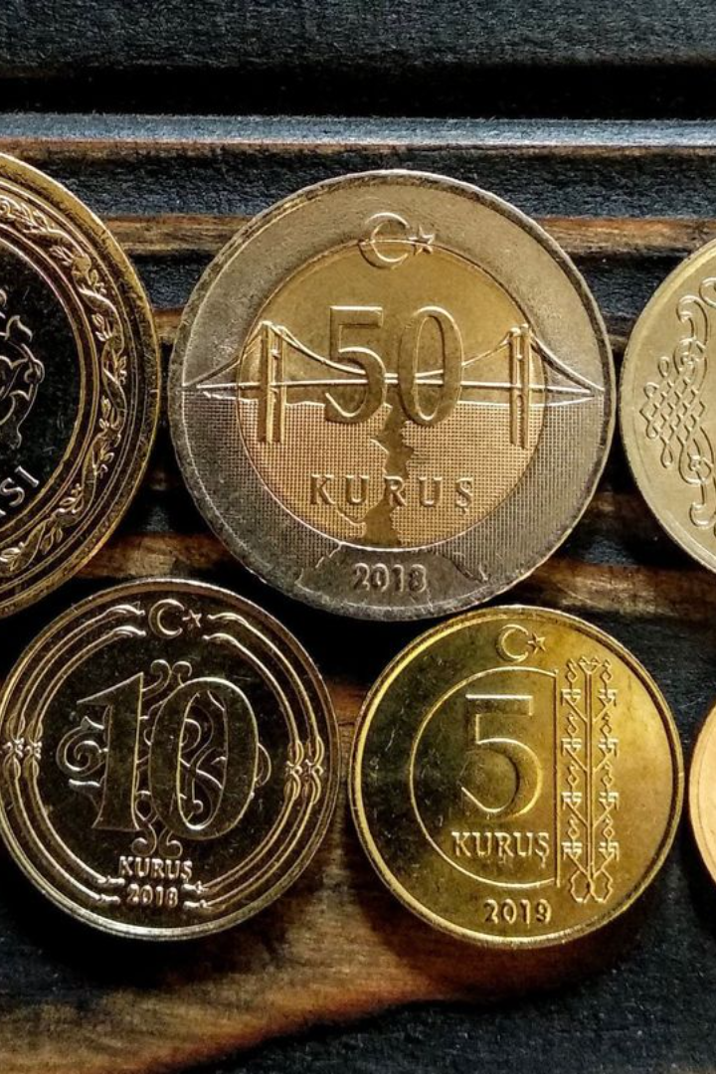
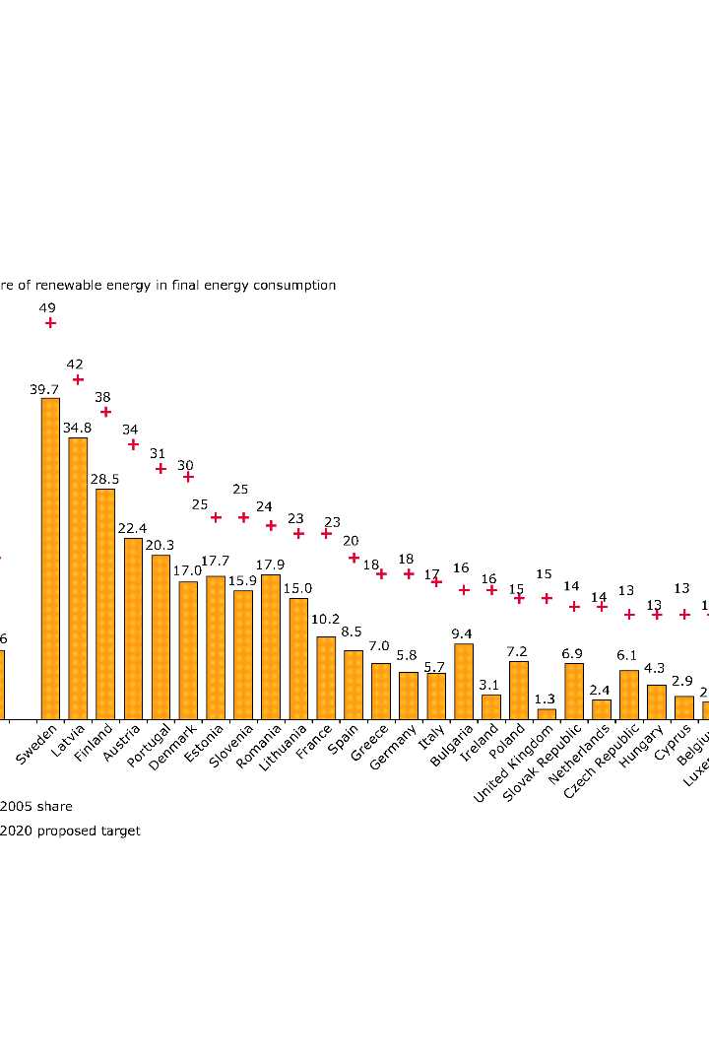

Forecasting Turkey’s Inflation
Arzu ISIK TOPBAS
CSCI E-116: Dynamic Modeling and Forecasting in Big Data
Fall 2023
AI

Slide 2
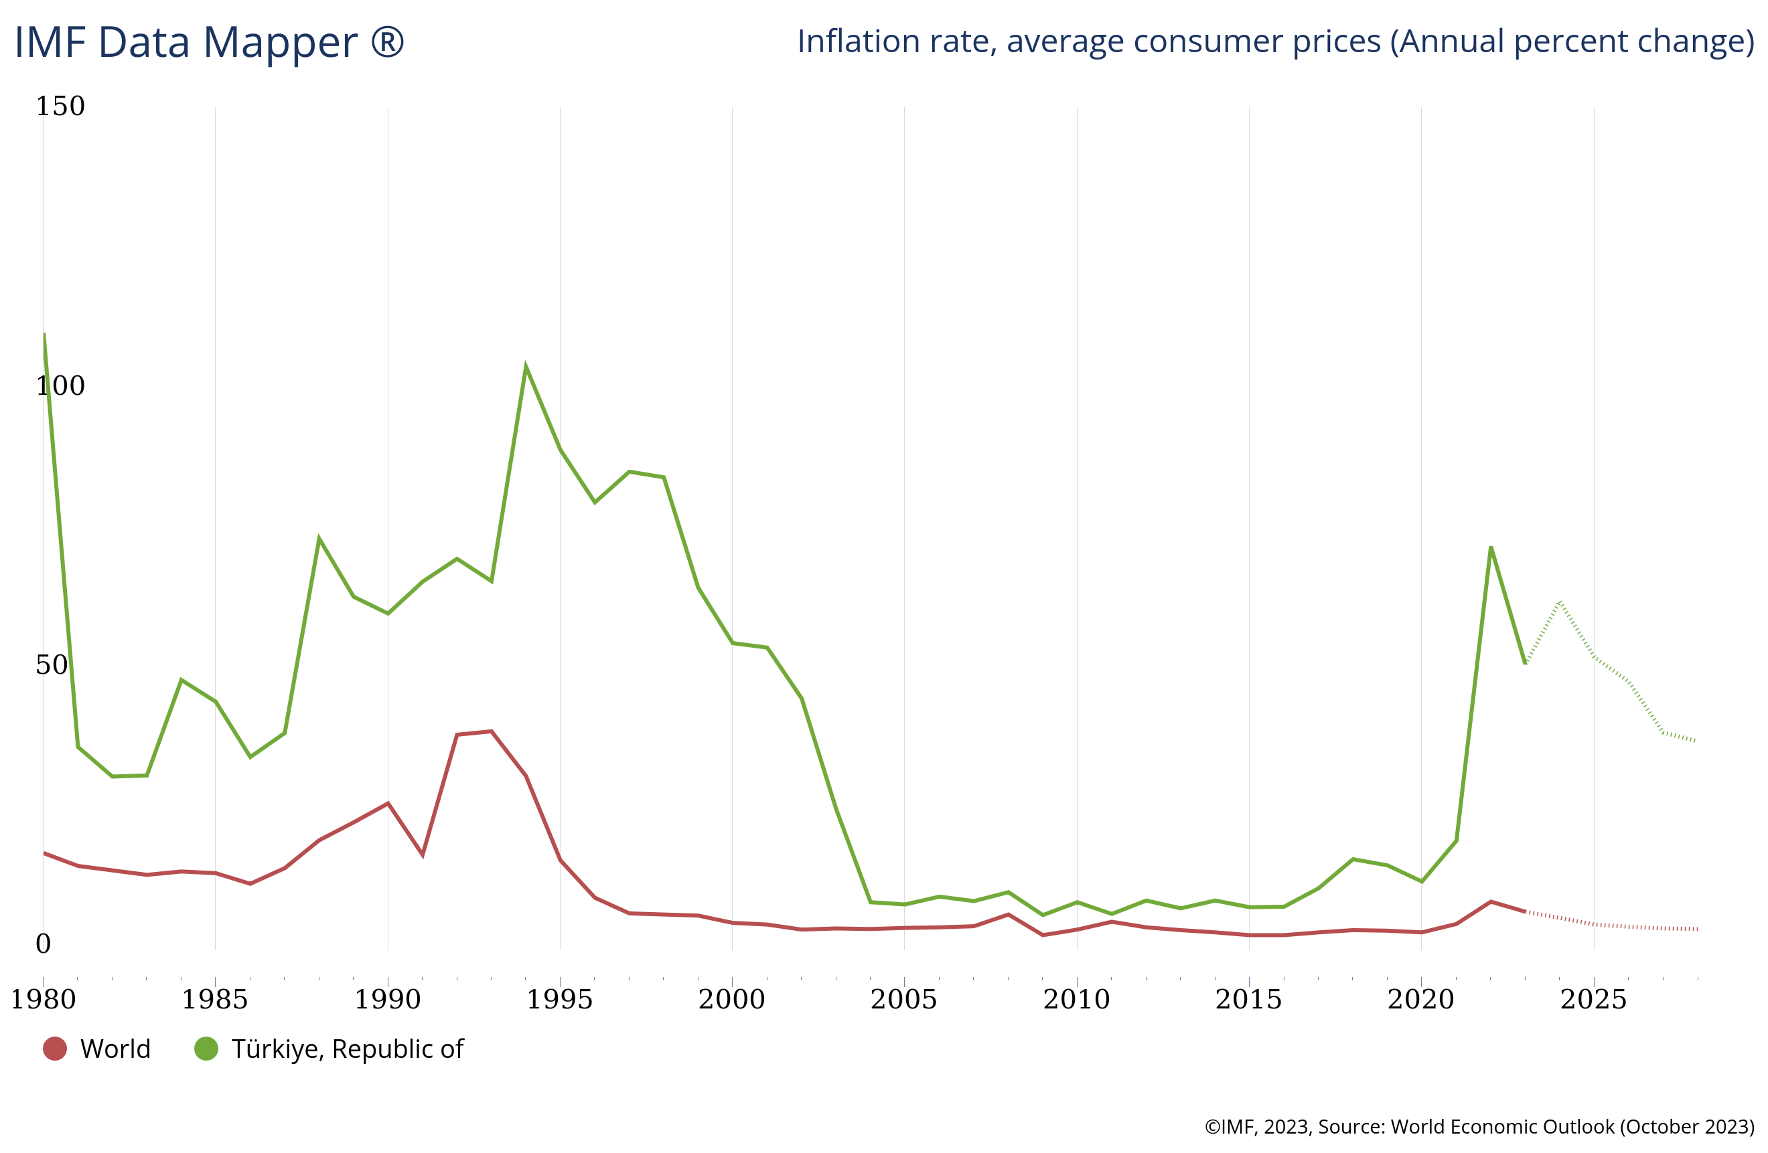
Overview

Slide 3
Data Sources and Economic Indicators
CPI - Consumer Price Index
Unemployment Rates
Gold and Oil Prices
Exchange Rates - USD
A measure of the average change in prices paid by consumers for a basket of goods and services.
A key economic indicator that measures the percentage of the total labor force that is unemployed and actively seeking employment.
Both gold and oil prices can serve as indicators of economic health.
Exchange rates refer to the value of one currency in terms of another.
Data Source:
Data Source:
Data Source:
Data Source:
OECD
TUIK
World Bank
CBRT
Interest Rates
Interest rates represent the cost of borrowing money or the return on investment for lending capital.
Data Source:
FRED

Slide 4
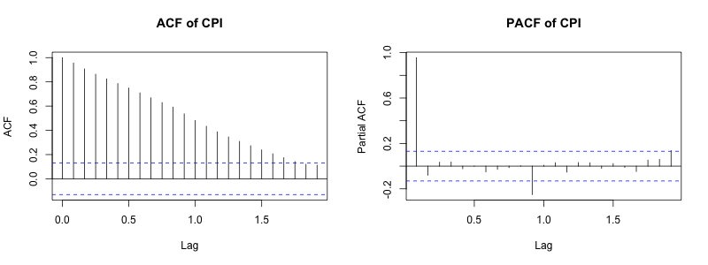
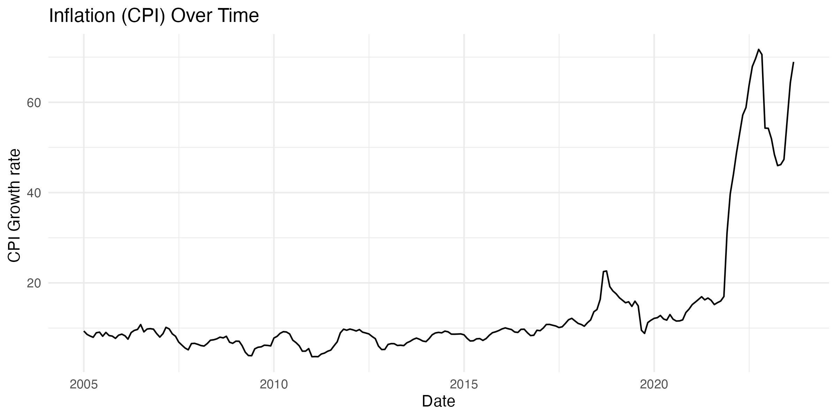
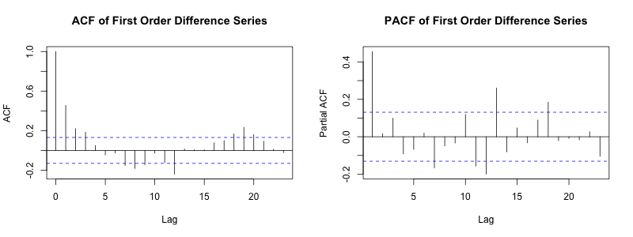
Stationarity
Non-Stationarity Challenges
The Augmented Dickey-Fuller (ADF) and Elliot, Rothenberg and Stock (ERS) unit root tests revealed non-stationarity in Turkey's Consumer Price Index (CPI).

Slide 5


Model Comparison
Regression Models
Time Series models
Linear Regression Models, Linear Regression Model with Log Transformation, Linear Regression Models with factor month and year Autoregressive (AR) Model
Prophet Model, ARIMA and SARIMA Models, Dynamic Factor Model (DFM), VAR Models, Structural Time SeriesAutoRegressive Moving Average (ARMA) Model, ARMAX Model

Slide 6
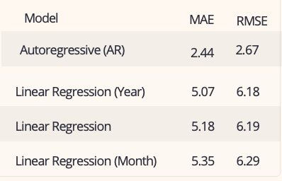
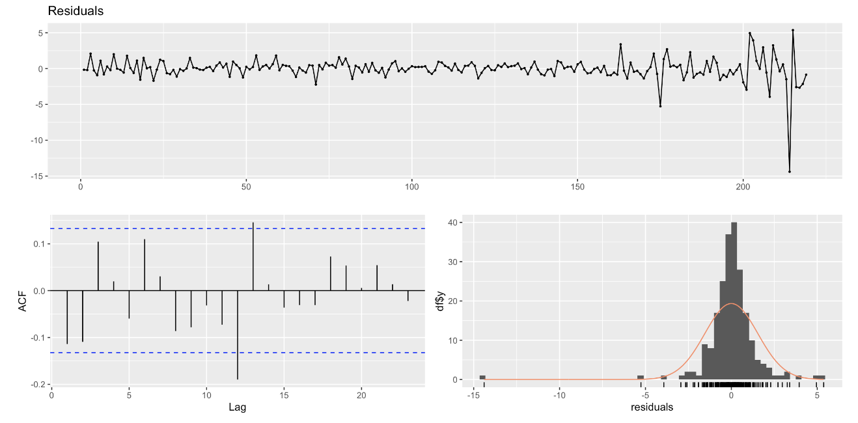
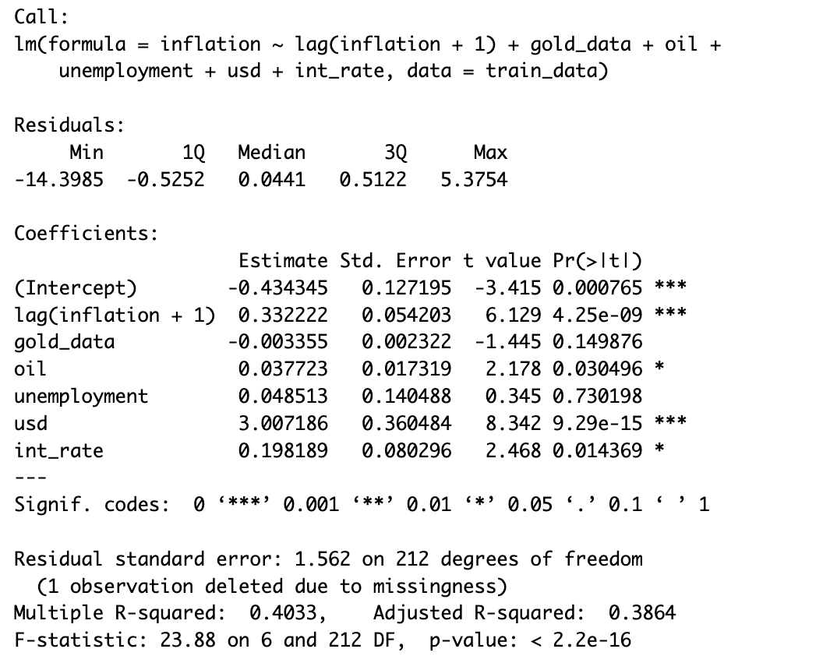
Regression Models

Slide 7
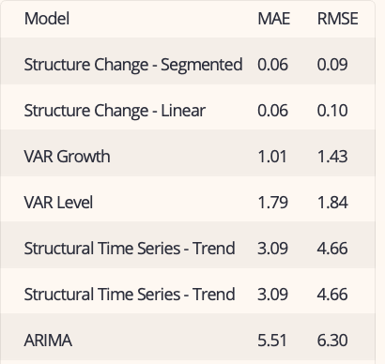
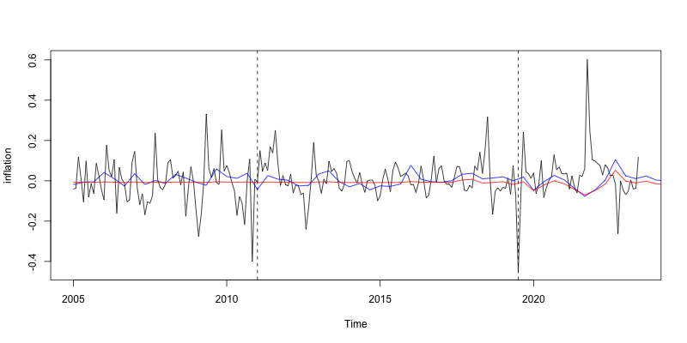
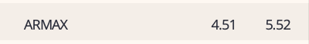
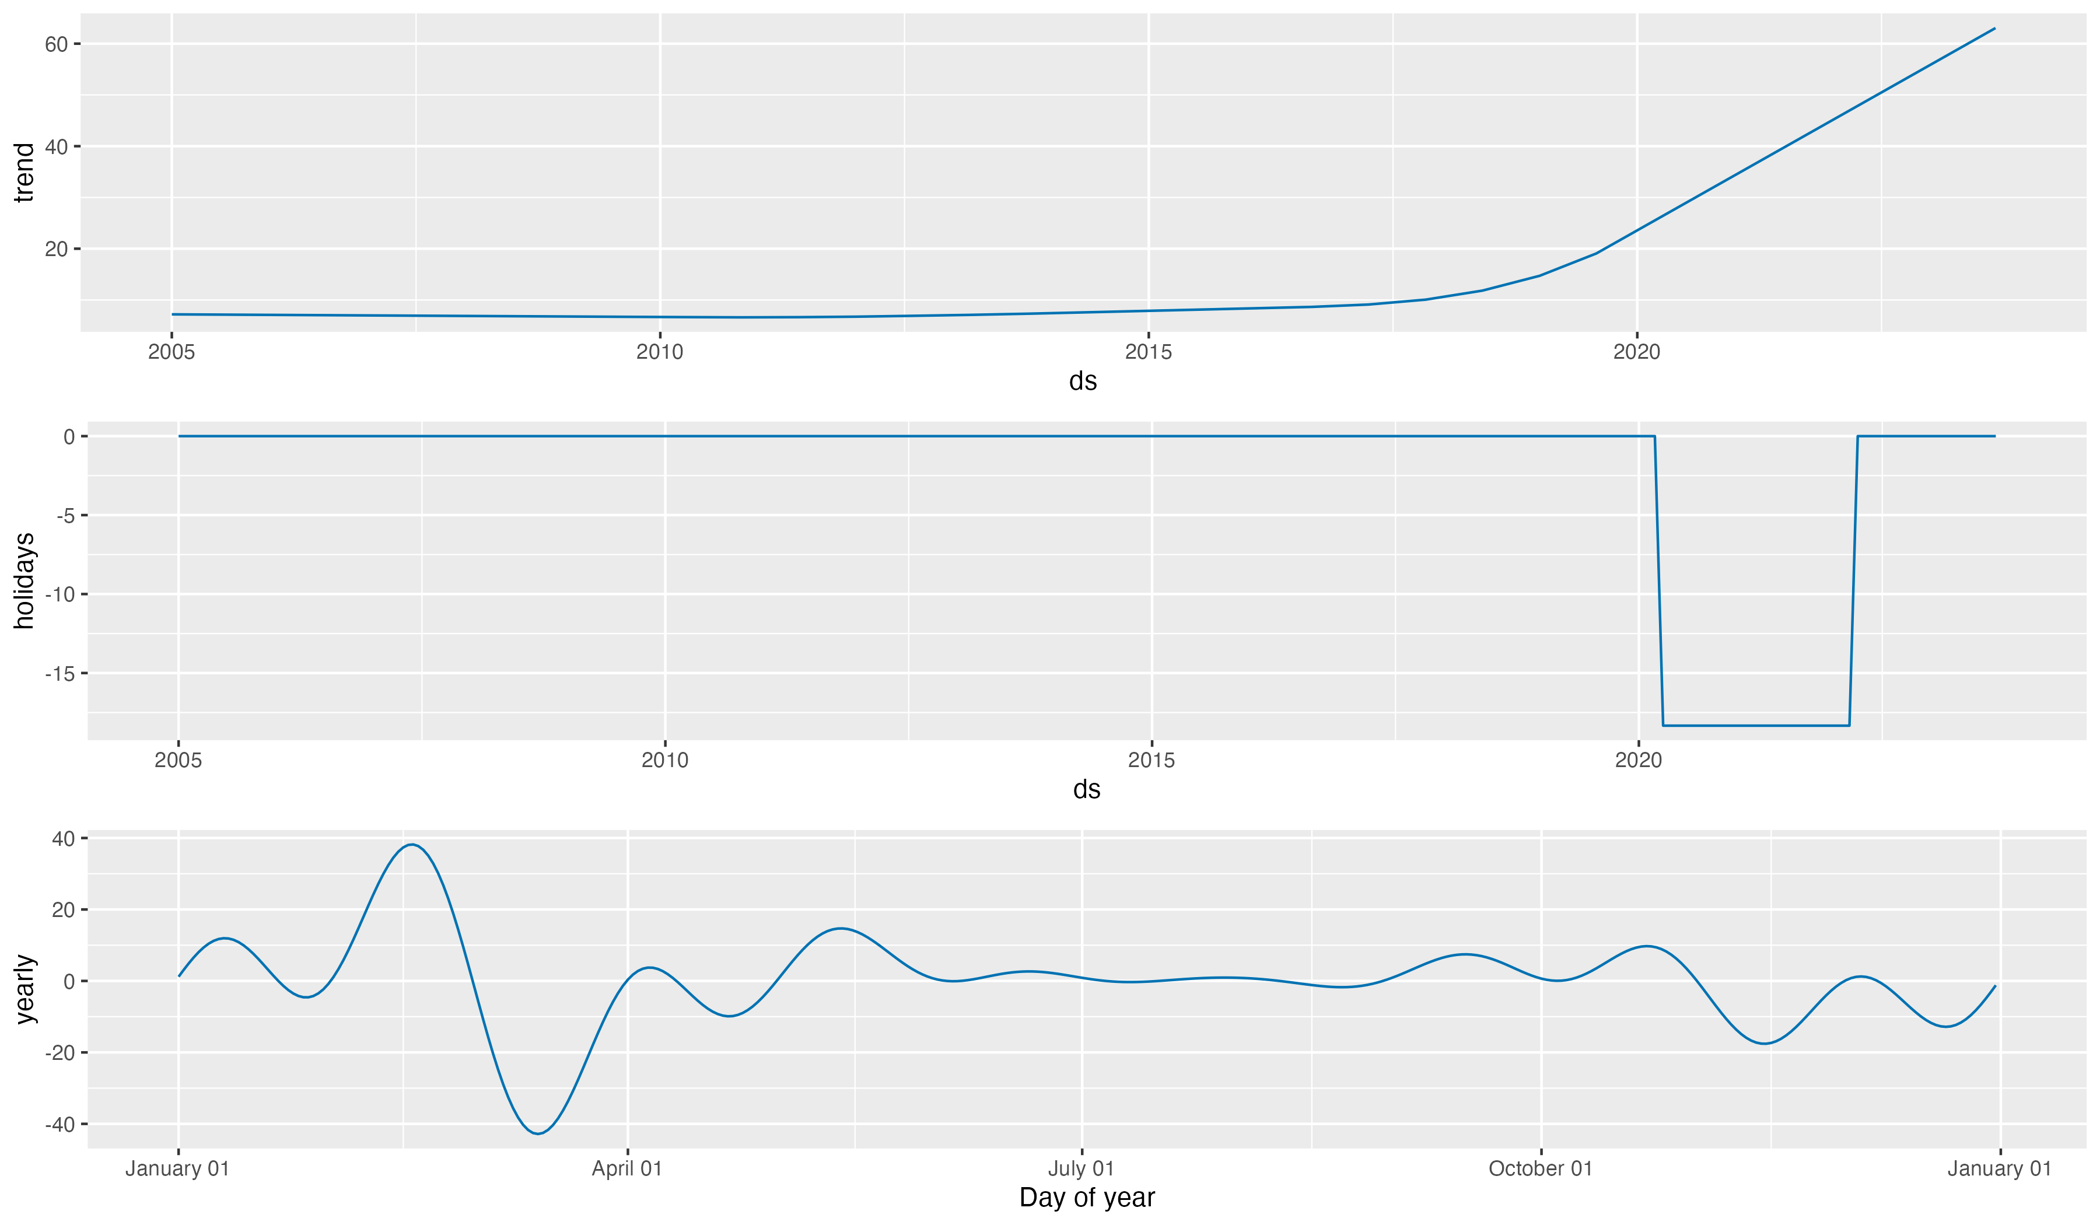
Time Series Models
2011
Syria civil war
2 major earthquakes
2019
Covid Pandemic

Slide 8
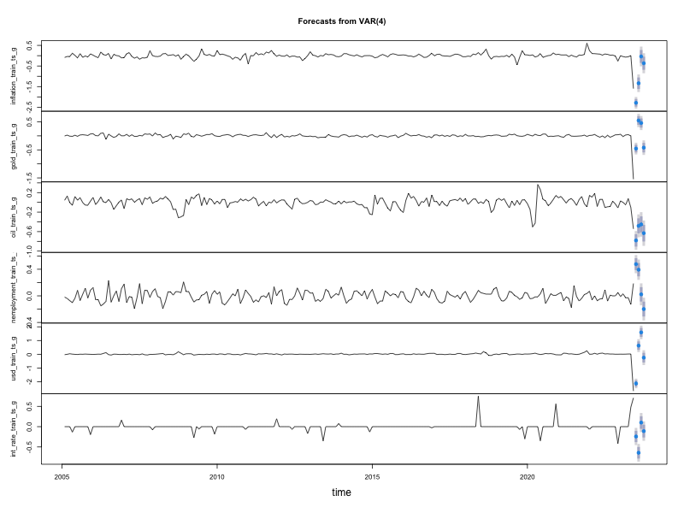
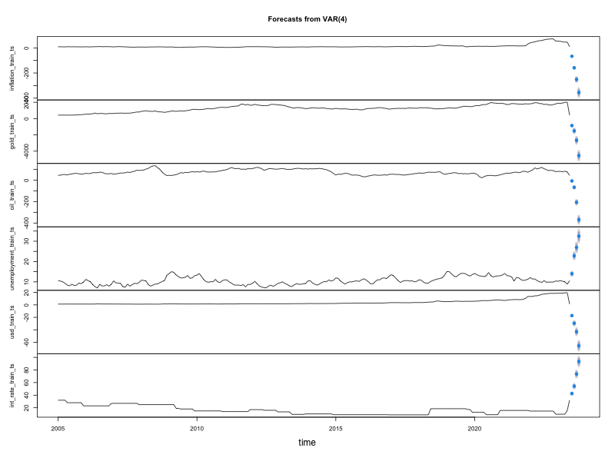
Results Forecasting Inflation
Model
MAE
RMSE
Structure Change - Segmented
0.06
0.09
Structure Change - Linear
0.10
0.06
VAR Growth
1.43
1.01
VAR Level
1.84
1.79
Autoregressive (AR)
2.67
2.44
Structural Time Series - Trend
4.66
3.09
ARMAX
4.51
5.52
Linear Regression (Year)
5.07
6.18
Linear Regression
6.19
5.18
Linear Regression (Month)
6.29
5.35

Slide 9

Future Directions for Research
Exogenous Variable Integration
Machine Learning Approaches
Governmental fiscal policies, international economic data, geopolitical events
Neural networks, gradient boosting, deep learning architectures
Long Term Forecasting
Check Long term forecast accuracy

Slide 10

Thank you!
Arzu ISIK TOPBAS
arzuu.isik@gmail.com
Notes:
Thank you for everyone.

